Slide 1
DTW with Confidence Intervals
ENGR207 – Digital Signal Processing
Instructor: Prof. TJ Tsai
Team: Patrick Liu, Javier Perez, Jeremy Kim, Hamza Jamal
5.3.24
Notes:
We are investigating DTW with Confidence Intervals. The team consists of Patrick, Javier, myself, and Hamza.

Slide 2
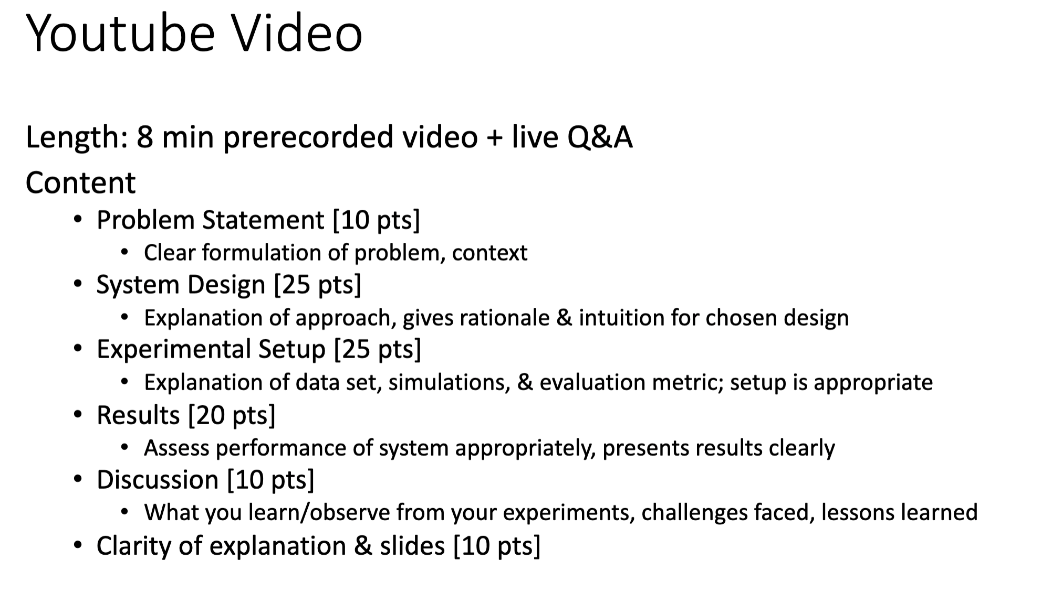

Slide 3
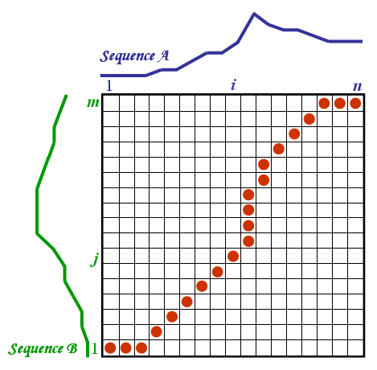
Project Motivation
DTW (Dynamic Time Warping) is used to calculate the optimal path between two sequences using a pairwise cost function. The final cumulative score is often used to describe how well the two sequences match.
However, this doesn’t tell us the confidence for a specific interval in the sequences. Thus our team is tasked with finding a way to best characterize the confidence level of specific intervals within the path.
Notes:
For some project motivation, DTW calculates the best alignment between two sequences using a pairwise cost function.
DTW typically provides a cumulative score that indicates the overall similarity between the two sequences, but it doesn't give us detailed information about the confidence level at different points along the alignment path.
Characterizing confidence levels within DTW alignments leads to improved reliability and interpretability of the results.

Slide 4
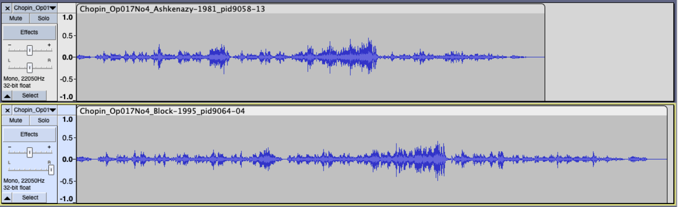
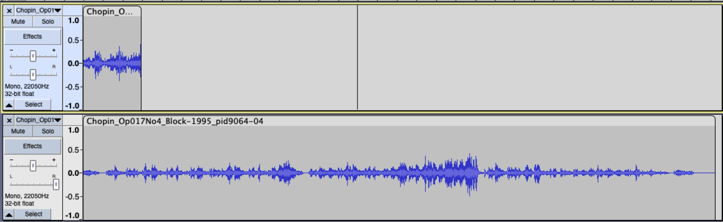
Full Alignment vs. Subsequence Alignment
For this project we split up into subteams, A and B.
Team A: Full Alignment
Focused on aligning two full recordings against each
Team B: Subsequence Alignment
Focused on aligning a full recording with a short query section of a recording
Notes:
There were two cases we wanted to test. One is the full alignment case where we compare two full recordings, and the subsequence alignment case where we compare a full recording with a short query of another recording.
For the interest of time, we ran simulations on only the full alignment case. The algorithm should function the same with subsequence alignment, so we had to make sure that our tests worked on the full alignment case first.

Slide 5
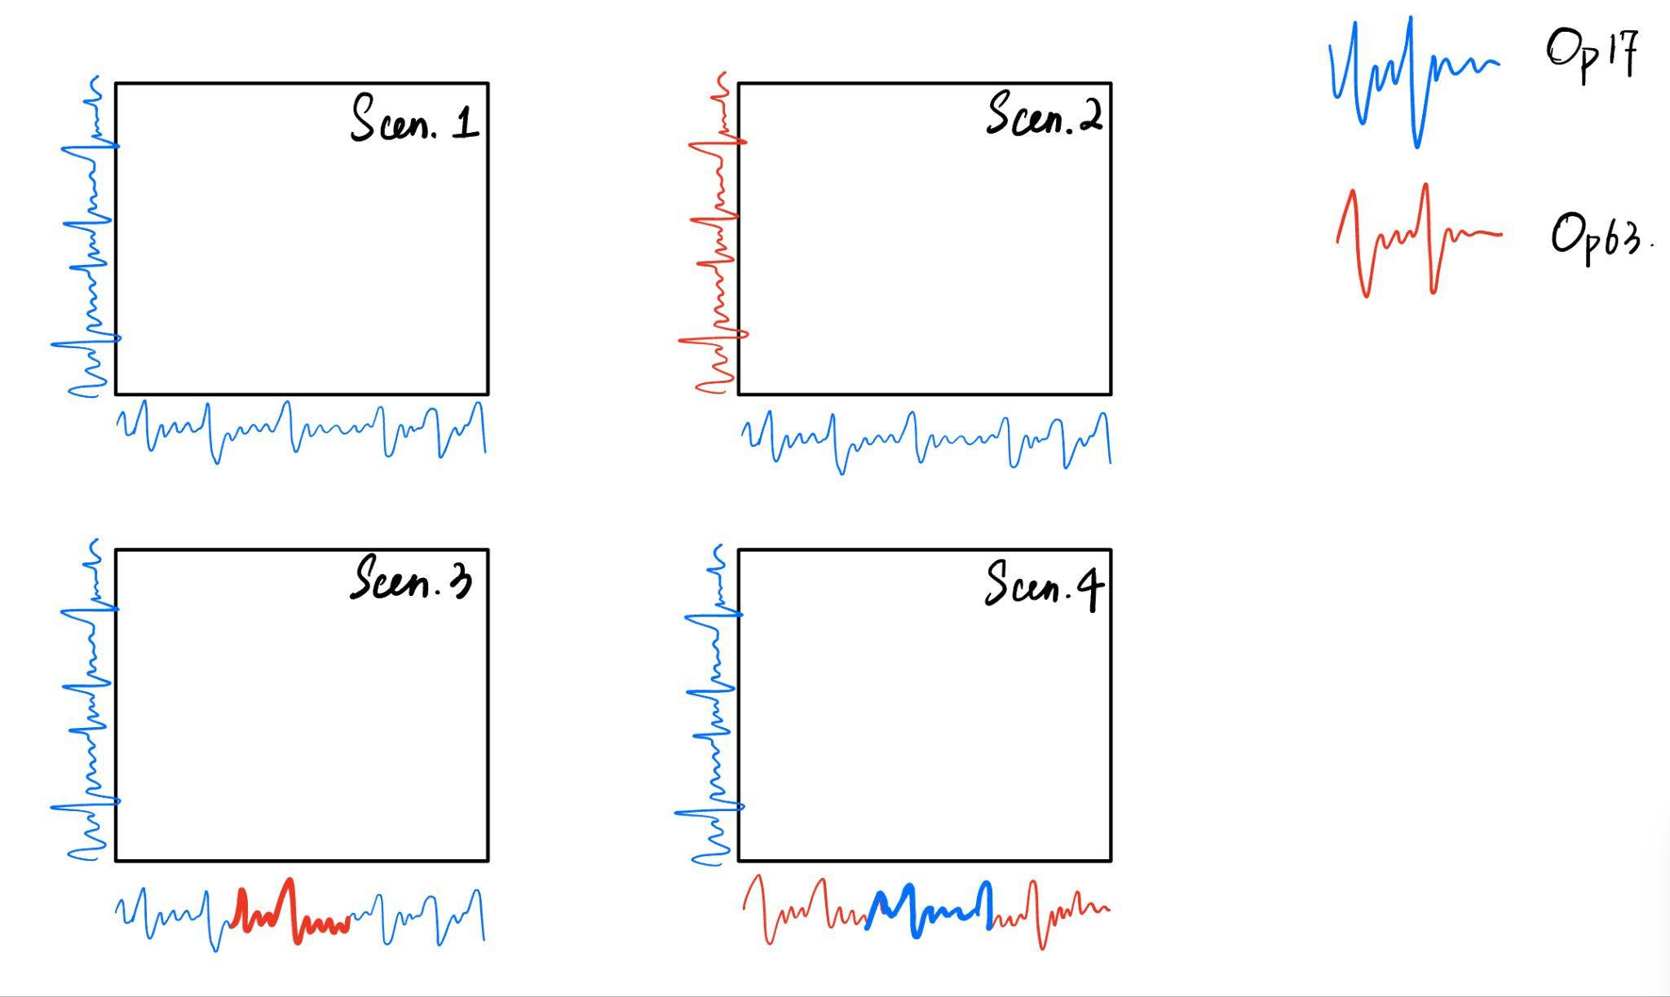
4 Scenarios
Scen. 1
Scen. 2
Matching
Non-Matching
Matching with Non-Matching Center
Non-Matching with Matching Center
Scen. 3
Scen. 4
Notes:
Here are the four scenarios we are testing, and what we predict the confidence intervals would be at various sections.
First we are aligning two matching pieces. Second, we are aligning two different pieces.
Third we are aligning two matching pieces, where the middle of one is swapped out for a different piece.
And fourth is the inverse of the 3rd scenario, where only the middle is matching.

Slide 6
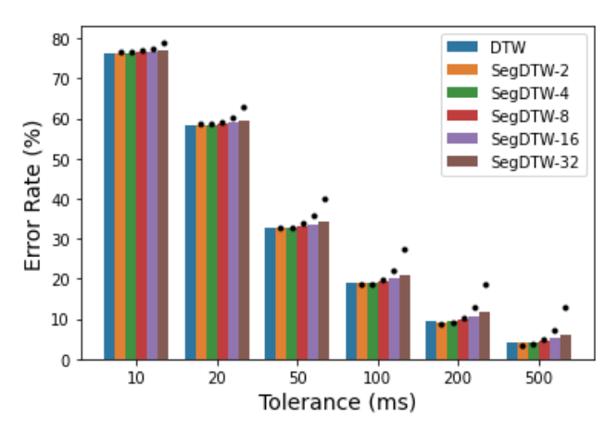
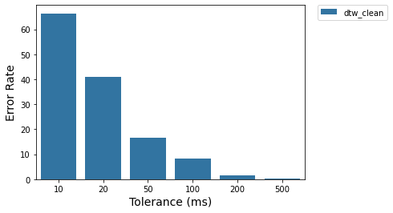
Replicating DTW results

Slide 7
Introductory Idea 1: Visualizing D, B
The first idea we were tasked with was to simply visualize the D and B matrix, and see what observations we could make on the confidence of the alignment.
14 | 10 | 13 | 9 | 10
9 | 7 | 6 | 7 | 11
6 | 8 | 4 | 8 | 12
5 | 2 | 5 | 9 | 17
1 | 4 | 7 | 10 | 11
↑ | ↑ | ↑ | ↗ | ↗
↑ | ↗ | ↑ | ↗ | ↗
↑ | ↑ | ↗ | ↗ | →
↑ | ↗ | → | → | →
 | → | → | → | →
D Matrix
B Matrix

Slide 8
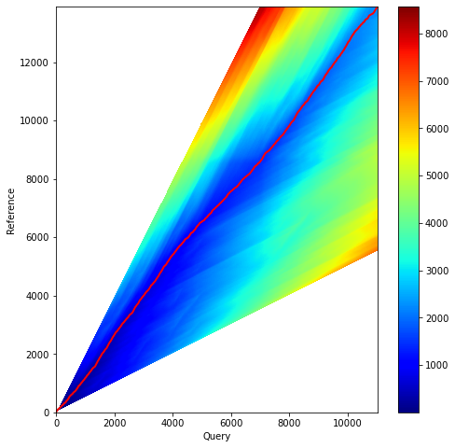
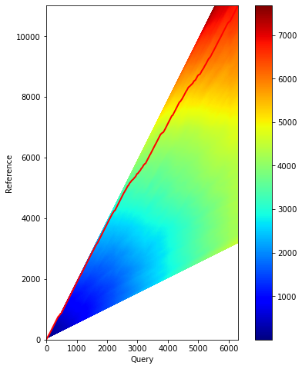
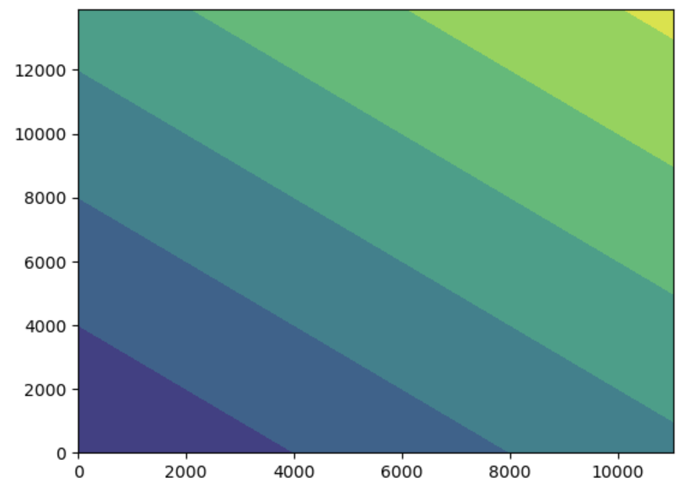
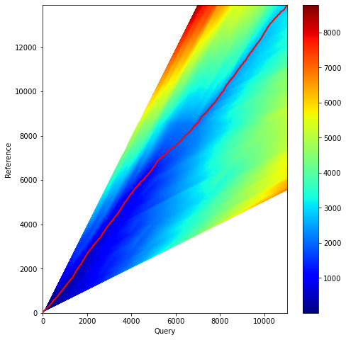
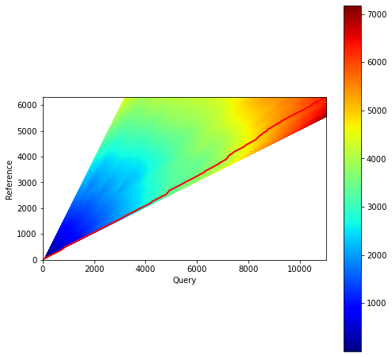
Scenario 1
Scenario 2
Scenario 3
Scenario 4

Slide 9
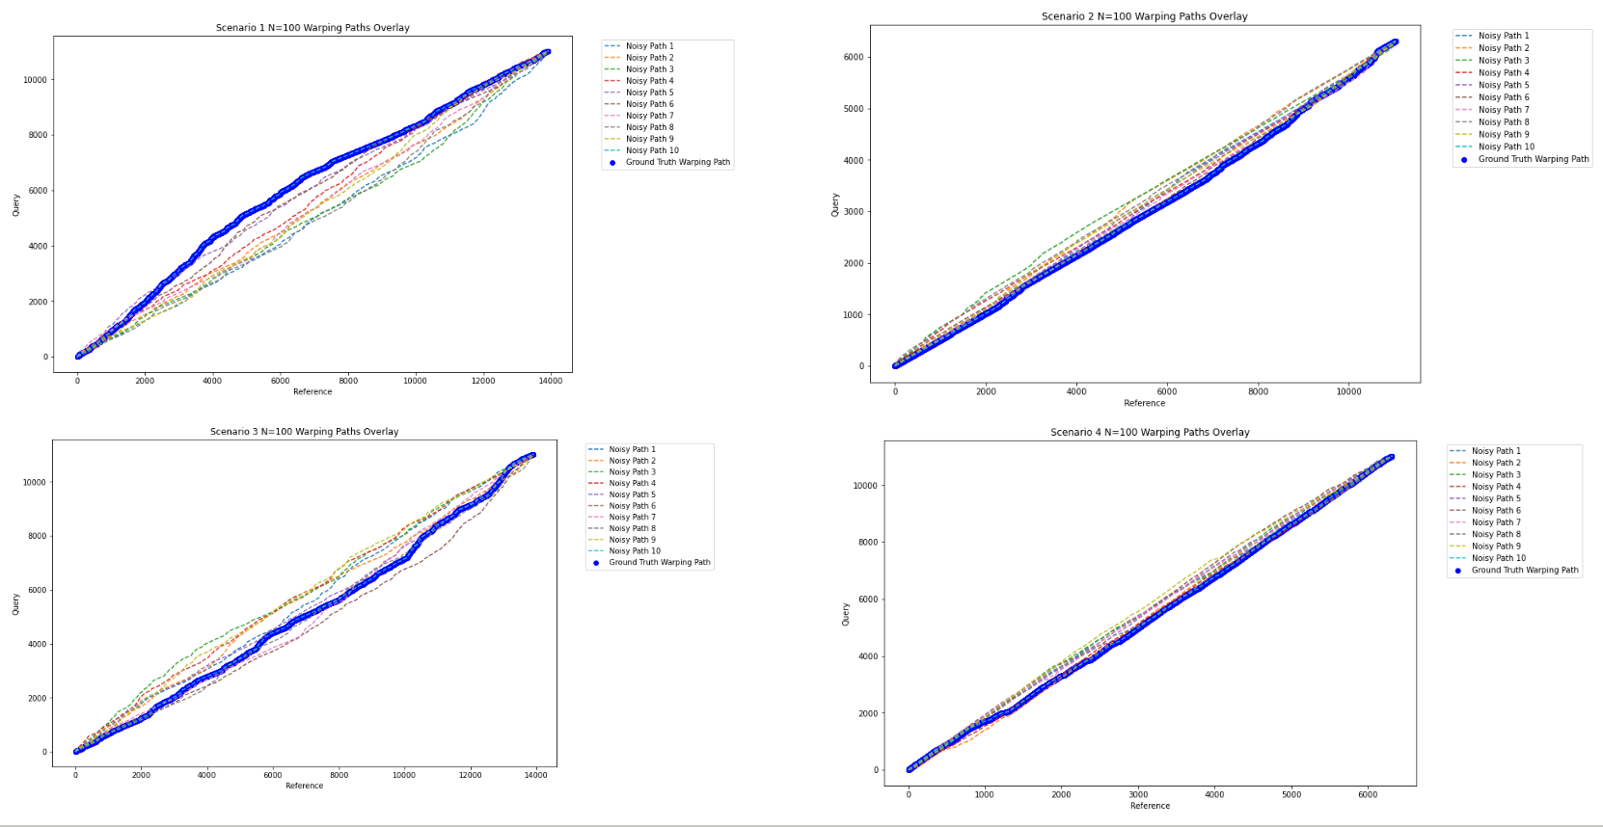

Slide 10
Idea 2: Backtrace Voting
For this idea we would first find D and B normally, then backtrace from every 50-unit element within the B matrix. We would accumulate a vote for every position in all the alignment paths generated. We would then tally the votes and visualize them.
 |  |  |  |  |  |  |  |  | O
 |  |  | O
 |  |  |  |  |  |  |  |  |  |  |  | O
 | O
Original Backtrace
Backtrace with Offset
Start of Backtrace with Offset
O
Notes:
Backtrace voting is to assess the robustness of DTW alignment. This approach involved accumulating votes from all feasible alignment paths determined by the cost matrix D and backtrace matrix B. For this, we sampled points at a 50-unit interval across the cost matrix D, computing backtrace paths to the origin from each point and updating the vote tally for each matrix cell encountered along the paths.

Slide 11
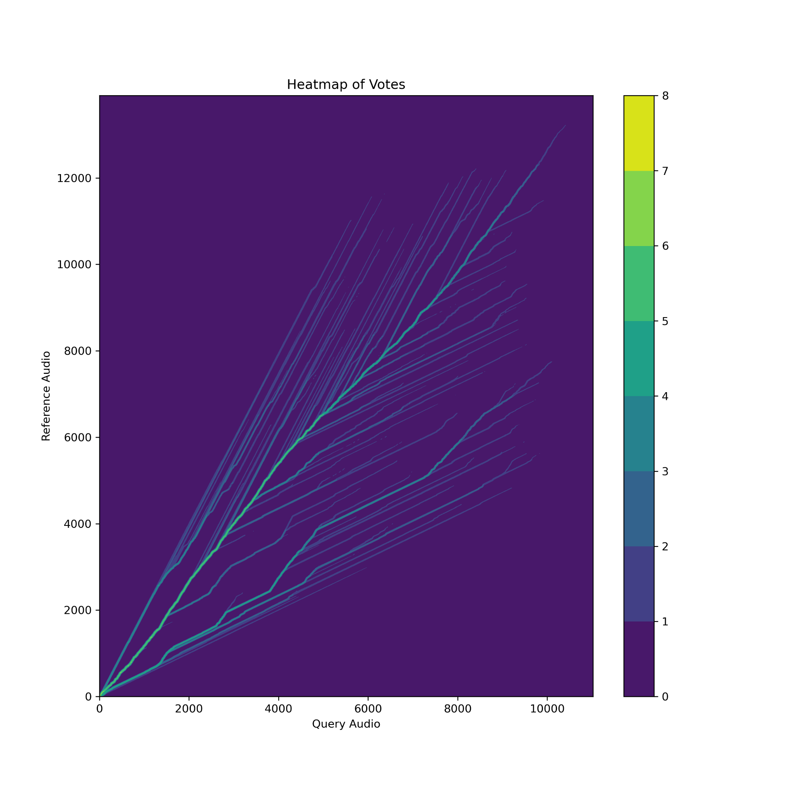
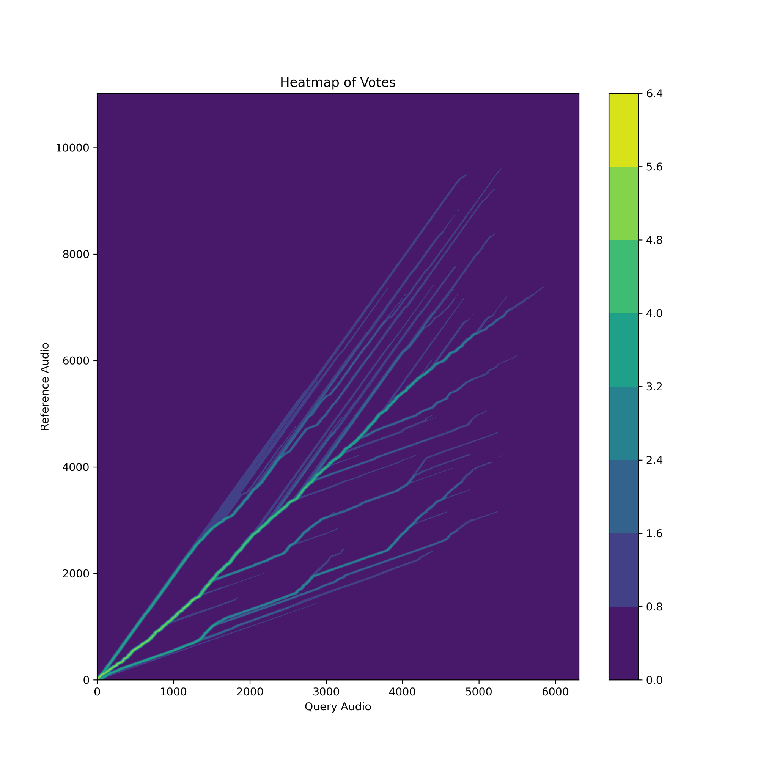
Backtrace Voting Visualizations
Scenario 1
Scenario 1
Scenario 2
Notes:
Scenario 1: Pattern of Main Stream and tributaries. Strong Alignment everywhere;
Scenario 2: Pattern of divergence from the origin, Weak Alignment indicated.

Slide 12
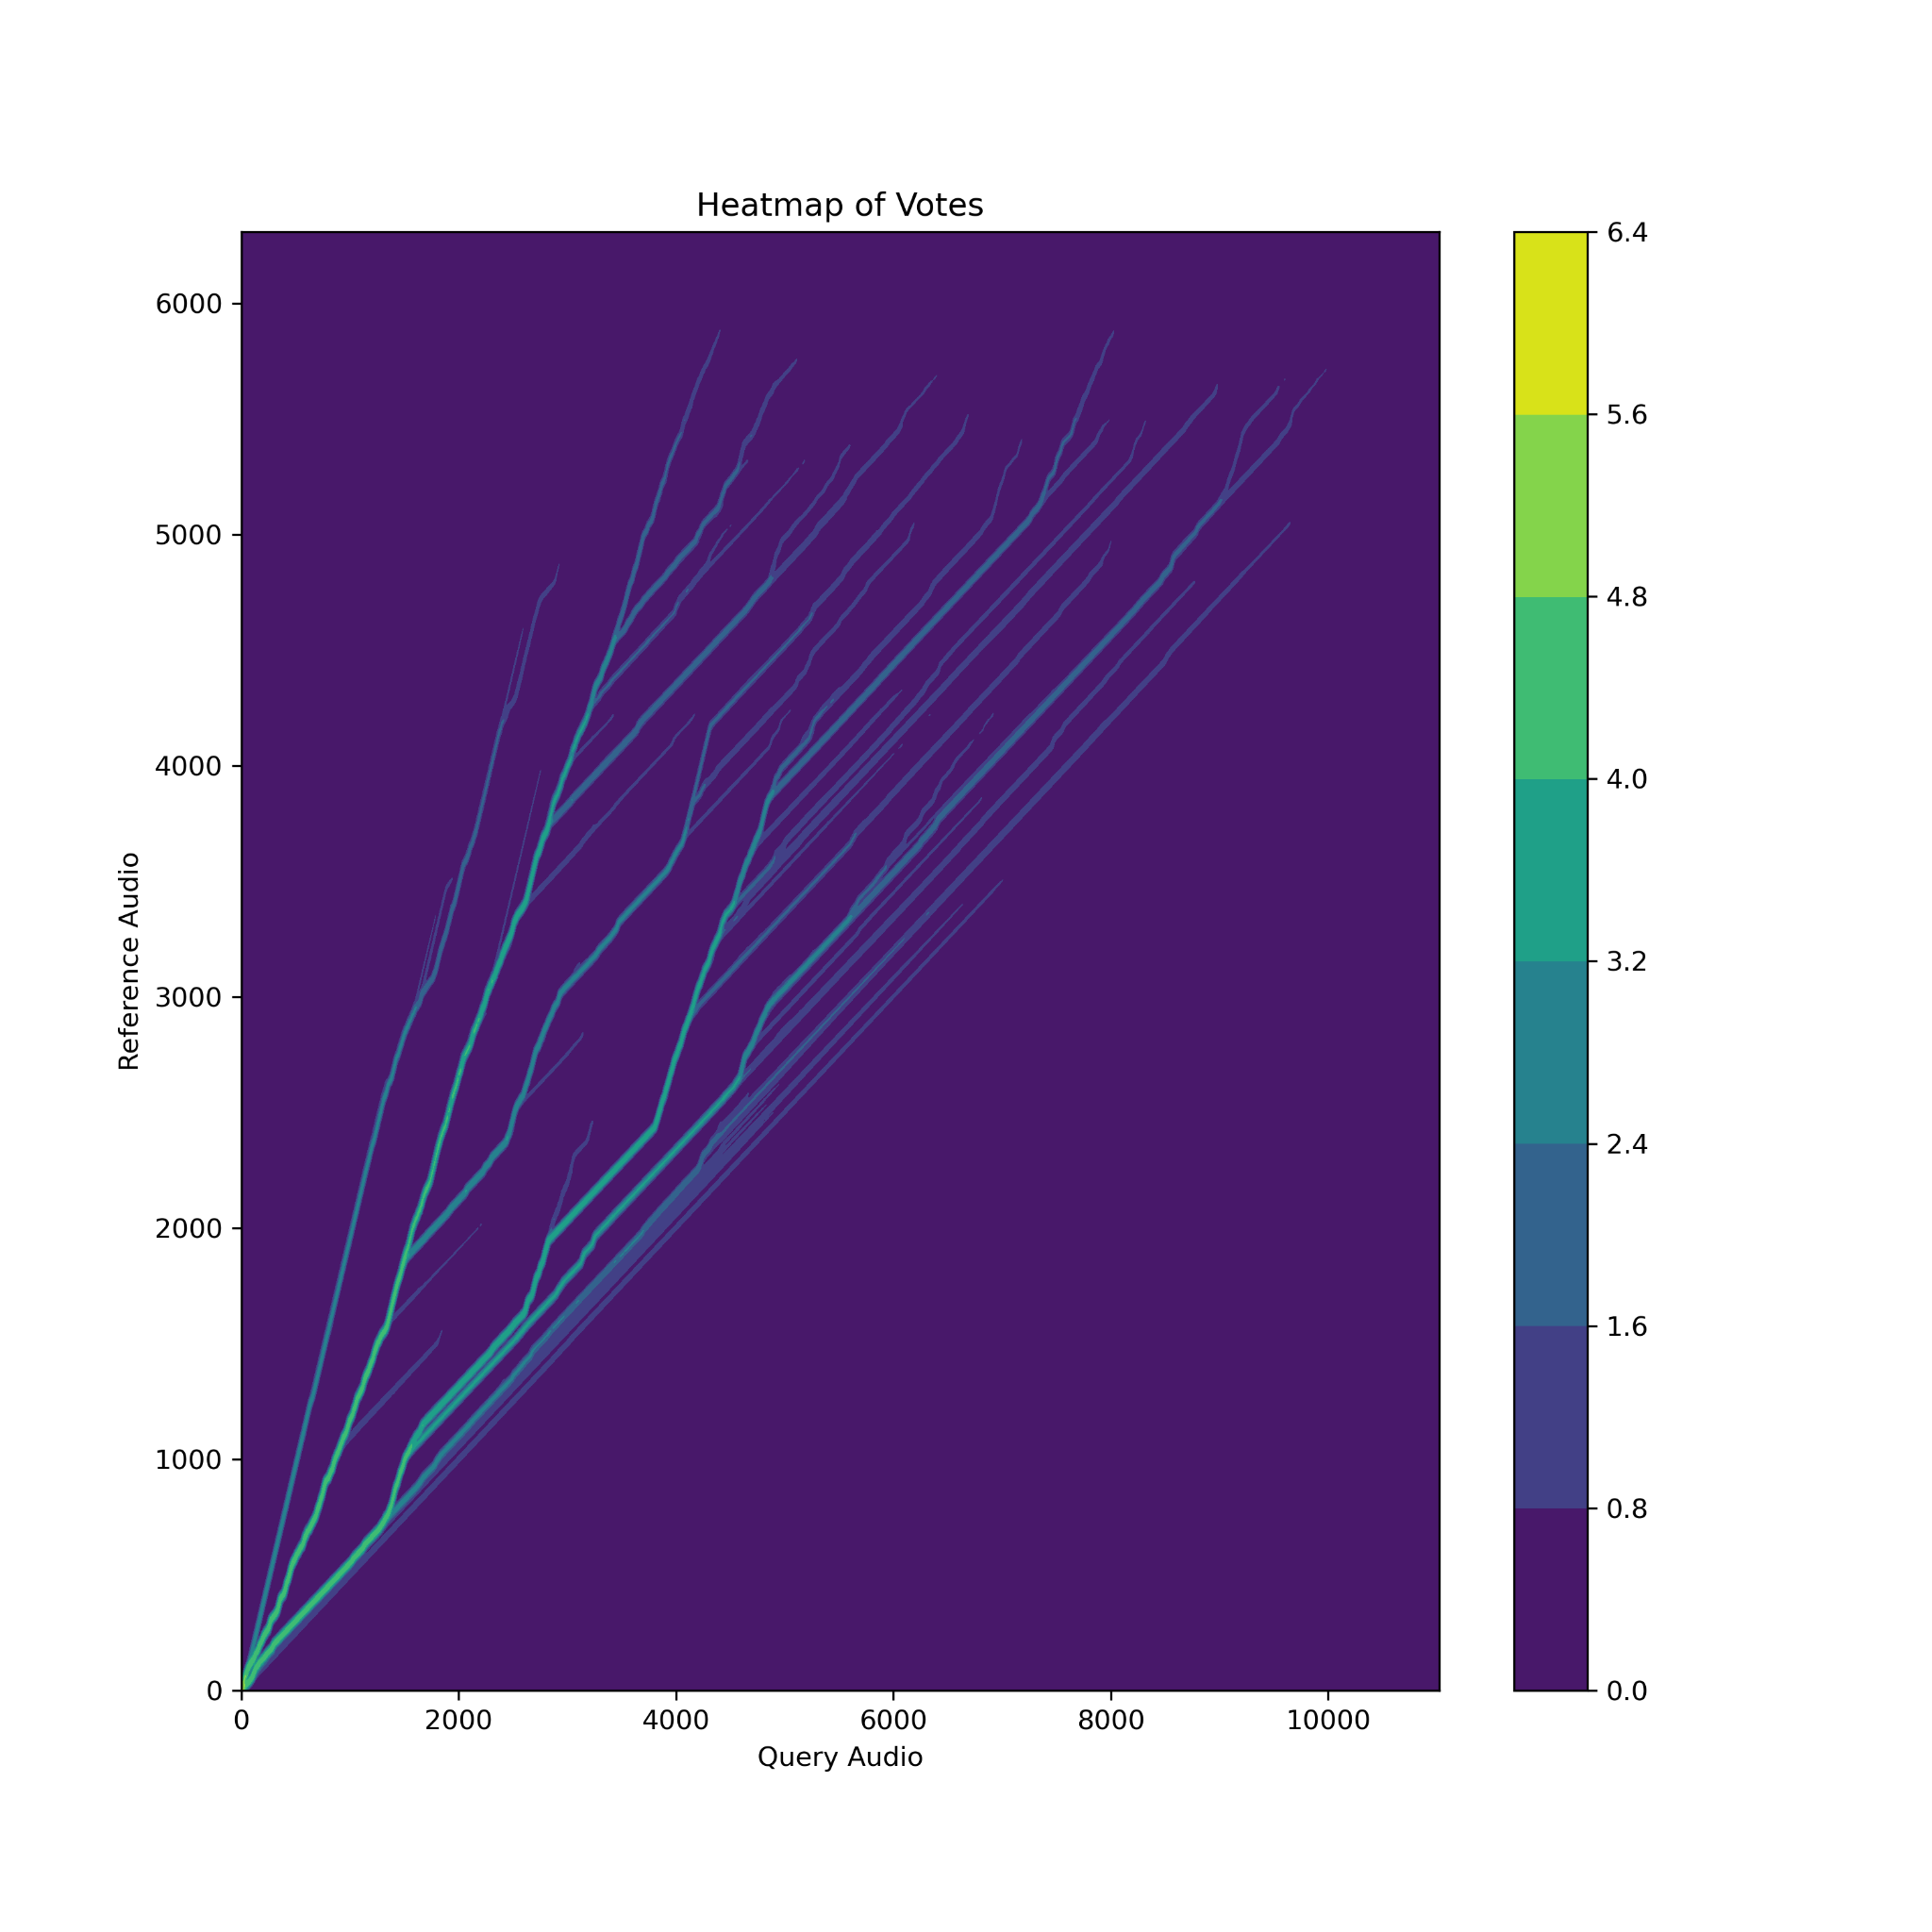
Backtrace Voting Visualizations
Scenario 3
Scenario 4
Notes:
Same Pattern above.
No difference at the place where we insert non-matching audio piece or matching audio piece.
DTW is sensitive to the starting positions of sequences, which means initial alignments can be very similar if the starting audio segments match closely, even if discrepancies like a 30-second non-matching segment in the middle appear later in the tracks. These small local mismatches may not significantly affect the overall alignment pattern, especially if the rest of the audio is very similar, which makes the DTW algorithm prone to producing similar voting patterns by smoothing out these differences.

Slide 13
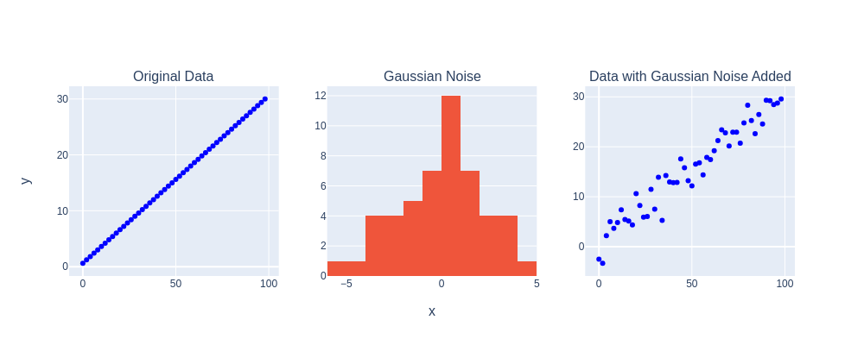
Idea 5: Adding Noise to the Features
Add white gaussian noise to the chroma features at a specified SNR. We’ll then calculate D, B, and the optimal path using these modified features and compare this noisy path with the original path. Vary the SNR to see its effect on the four scenarios.
Notes:
Idea five sought to explore how adding noise at different signal-to-noise (SNR) ratios affects the alignment path of our two recordings. We predicted that when an alignment is strong, minor noise additions will not significantly alter the alignment path and on the other hand, a weak alignment will show significant deviations from the ground truth path with the introduction of noise.
To test this. at each SNR we added noise to the feature matrices and recalculated the backtrace matrix for multiple trials. This allowed us to directly compare the optimal, ground truth path with the noisy backtrace paths.

Slide 14
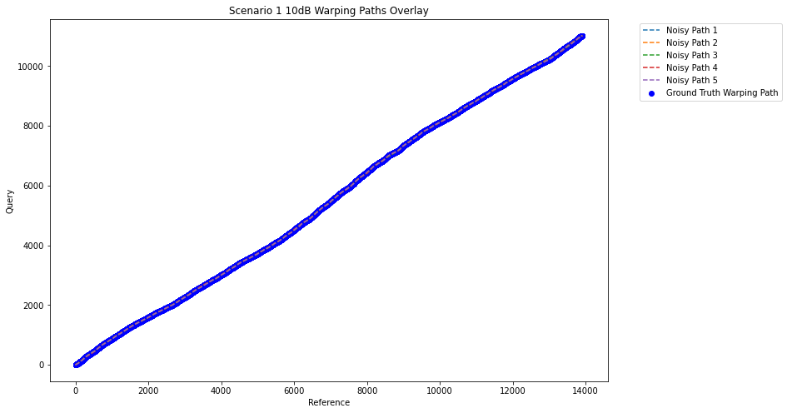
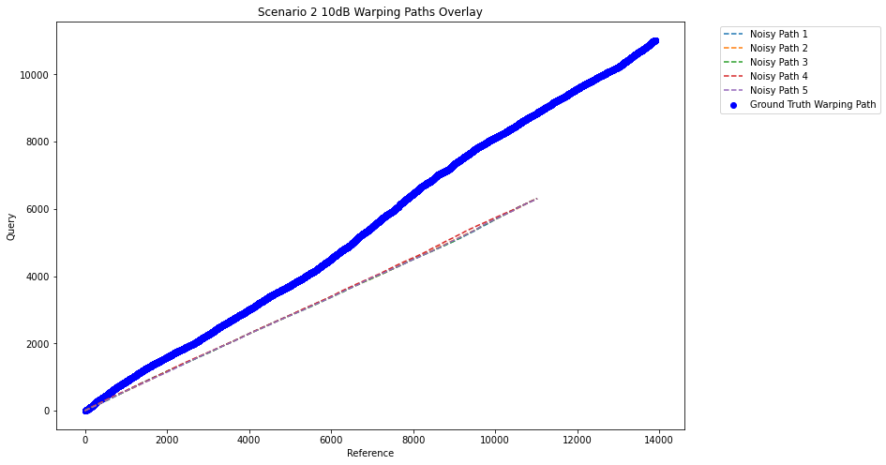
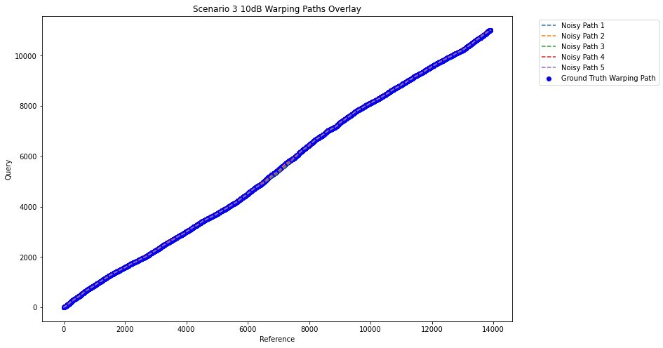
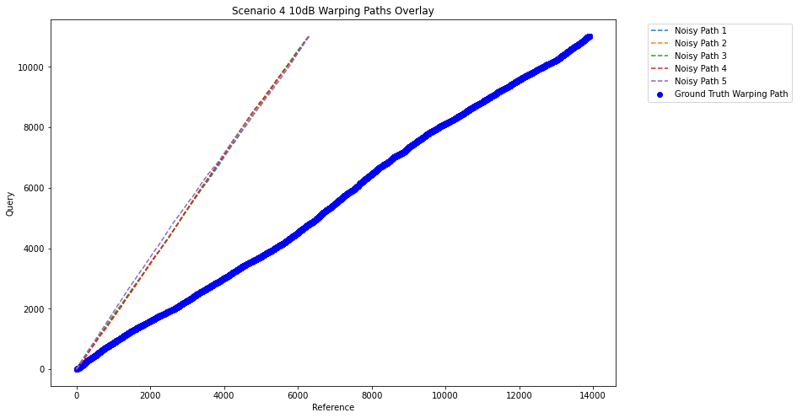
Idea 5 SNR = 10dB
Notes:
First, we have an SNR of 10dB. We see that in scenario 1 and 3, there is very little deviation from the ground truth path, whereas scenarios 2 and 4 immediately deviate from the ground path.

Slide 15

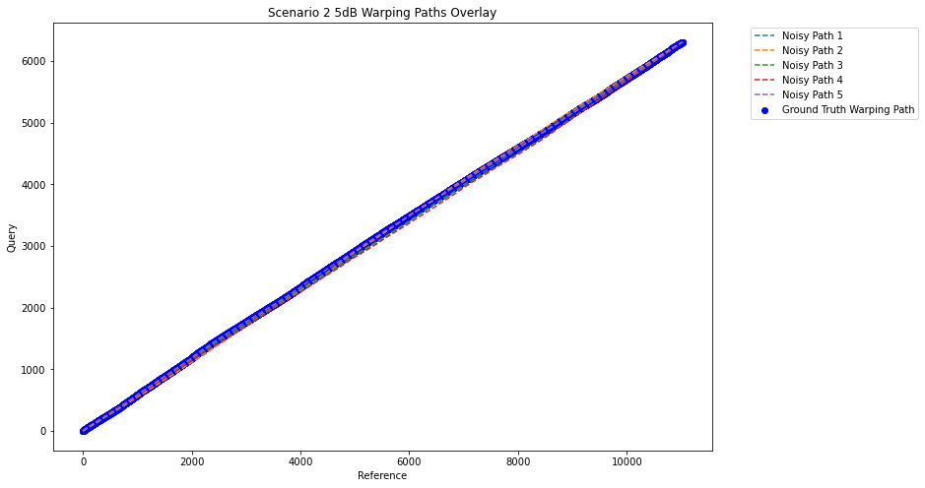

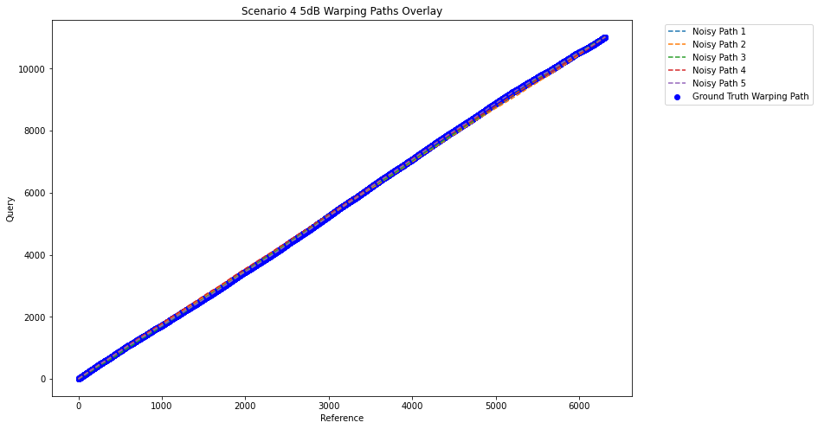
Idea 5 SNR = 5dB
Notes:
Next, with an SNR of 5dB, strangely we see that all of the paths are very well aligned. This does not line up with our intuition in that as we add more noise, the backtrace paths should become less similar to ground truth path.

Slide 16
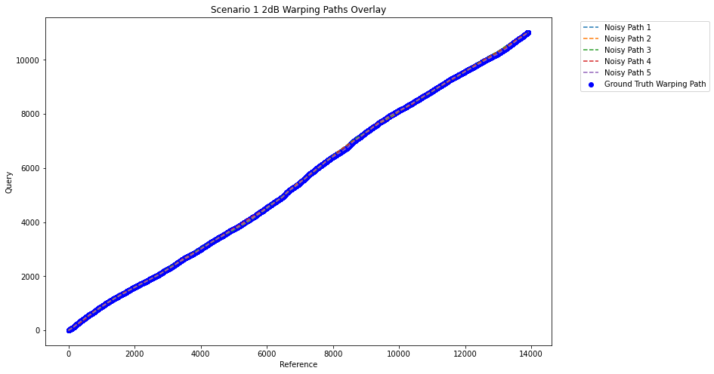


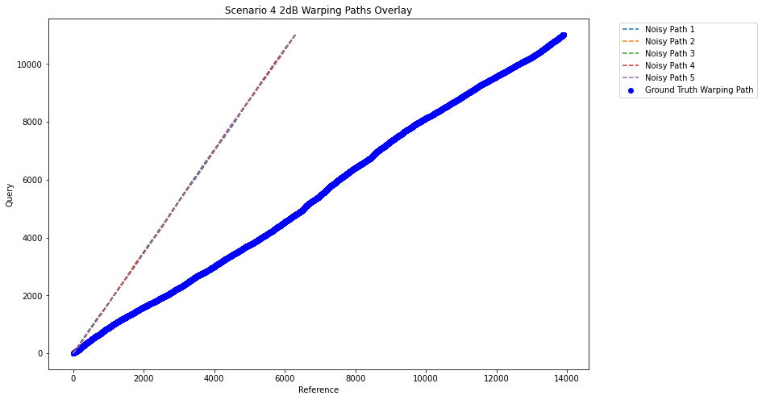
Idea 5 SNR = 2dB
Notes:
Finally, with an SNR of 2dB, we once again see that scenarios 2 and 4 deviate from the optimal path immediately.

Slide 17
Conclusions From Rejected Ideas
Unpredictable results from Idea 5
Heavily dependent on the initial alignment
Valley width and FlexDTW methods are independent of the starting point
Notes:
So for some conclusions from the rejected ideas, for idea 5, because the behavior of the alignment paths from going to SNRs of 10dB, 5dB, and then 2dB was seemingly random and unpredictable, we chose to abandon this idea. While the introduced noise at the local level was intended to simulate real-world variability, it also led to increased unpredictability in the alignment paths, making it challenging to derive consistent confident metrics that aligned with our intuition.
We discovered that the success of the algorithm is highly dependent on the initial alignment of the two recordings. As we saw in idea 5, scenarios 2 and 4, which were not initially aligned, immediately exploded away from the ground truth path. This is consistent with what we’ve found so far in that any idea that depends on the initial alignment will most likely fail to provide meaningful confidence metrics.
In the following slides, we will cover the valley width and flexdtw implementations, which are independent of the starting point and show more promise in establishing confidence intervals.

Slide 18
Ideas Moving Forward With

Slide 19
Idea 3: Valley Width of D[i,j]
Compute D and B normally. For each point on the path, consider all the elements that fall on it’s diagonal with slope -1. If we plot this diagonal, we should see a valley, we are tasked with visualizing this valley and measuring its width.
Original Backtrace
Diagonal
Notes:
After computing cost & backtrace matrix, we introduced an additional layer of analysis by examining valleys along the optimal path in D. Each point on this path was assessed for its neighboring values along a diagonal with a slope of -1, which enables us to visualize these values as a valley assuming the cost on the path would be relatively small.

Slide 20
Idea 4: Valley Width of D[i,j]
– How we calculate the valley width?
1. Find the decision line;
a. Average cost;
b. Minimum cost;
c. Maximum cost.
2. Count the number of points under the decision line;
3. Normalization
– Intuition: The wider the valley, The stronger the alignment at that point.
Notes:
To quantify these valleys, we devised a method to measure their width. First we calculate the average, minimum, and maximum costs along the diagonal, choosing the lowest value of them as a decision line. This allowed us to count the number of points below a decision line — defined by these cost metrics — and then normalize these counts by the total number of points considered. Since a wider valley suggests that small deviations from the optimal path still result in low alignment costs, we anticipated that the wider the valley, the stronger the alignment confidence at that point in the audio.

Slide 21
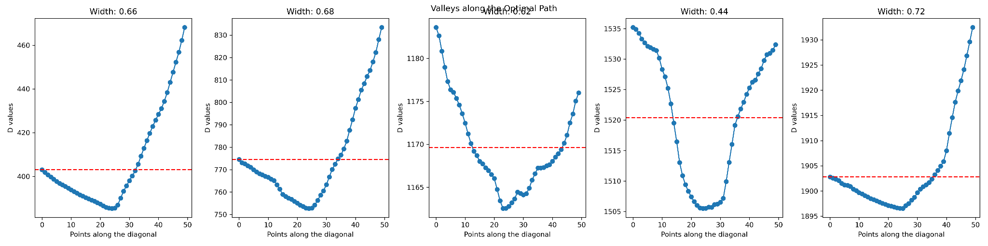
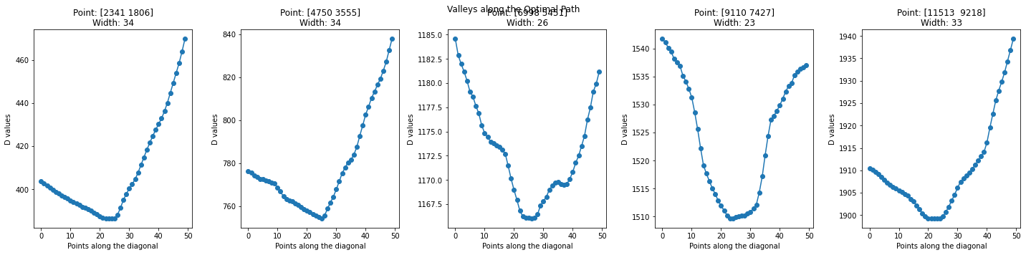
Idea 3 – Visualizations of 5 random valleys on the path
Observation Interval: 50
Scenario 1
Notes:
To validate our hypothesis of valley-shaped pattern of cost on diagonal of points lay on the optimal path, we first picked 5 equidistant points on the optimal path in 4 scenarios and plot the cost of 50 entries on the diagonal for each selected points.

Slide 22
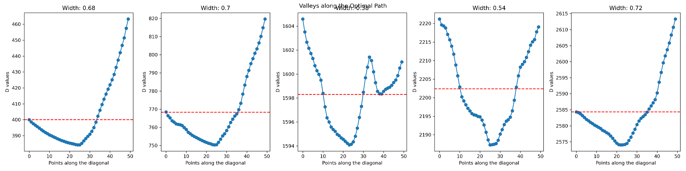
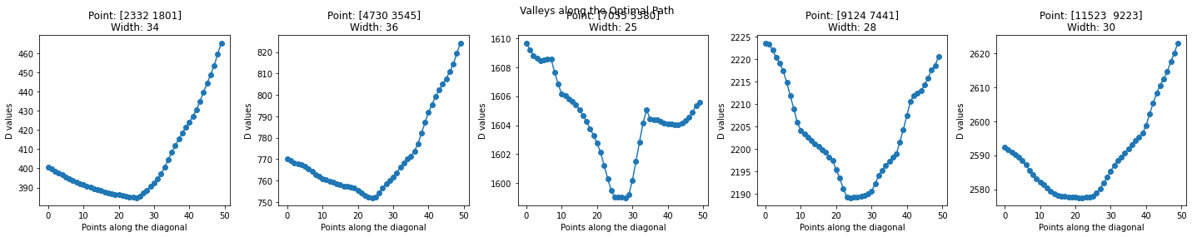
Idea 4 – Visualizations of 5 random valleys on the path
Observation Interval: 50
Scenario 3

Slide 23
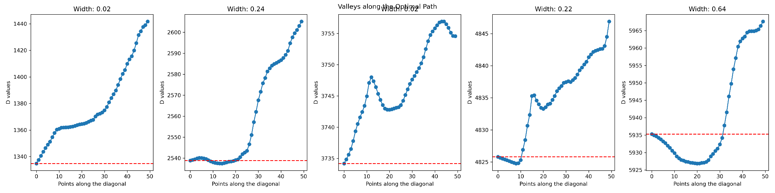
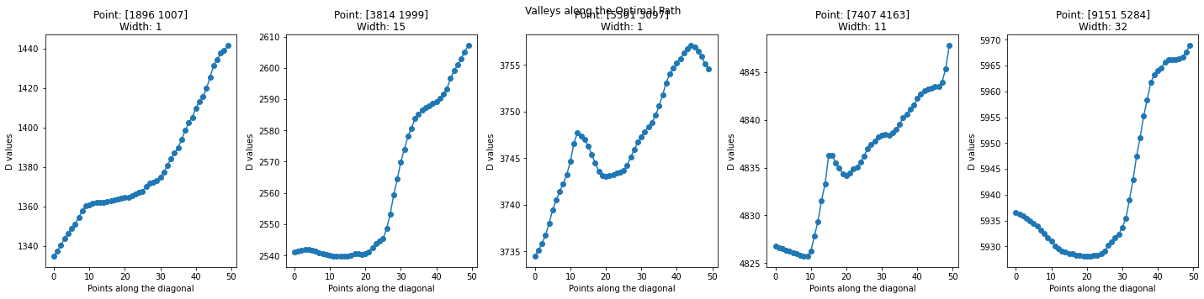
Idea 4 – Visualizations of 5 random valleys on the path
Observation Interval: 50
Scenario 2

Slide 24
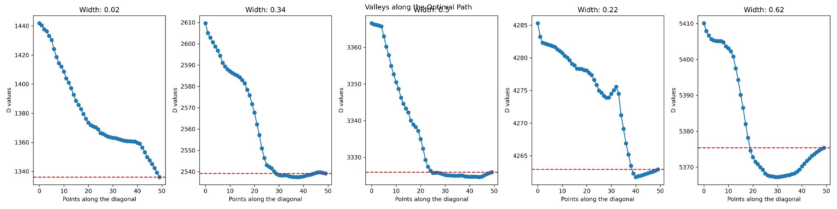
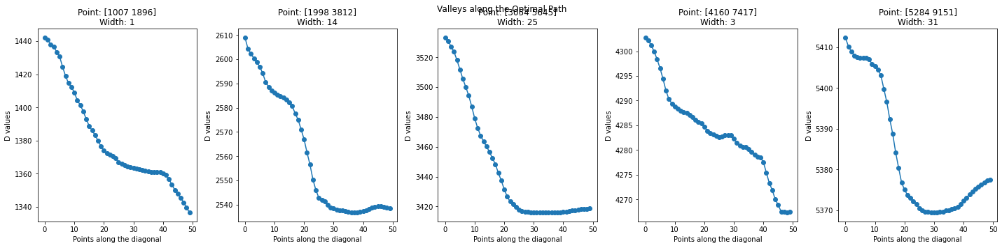
Idea 4 – Visualizations of 5 random valleys on the path
Observation Interval: 50
Scenario 4

Slide 25
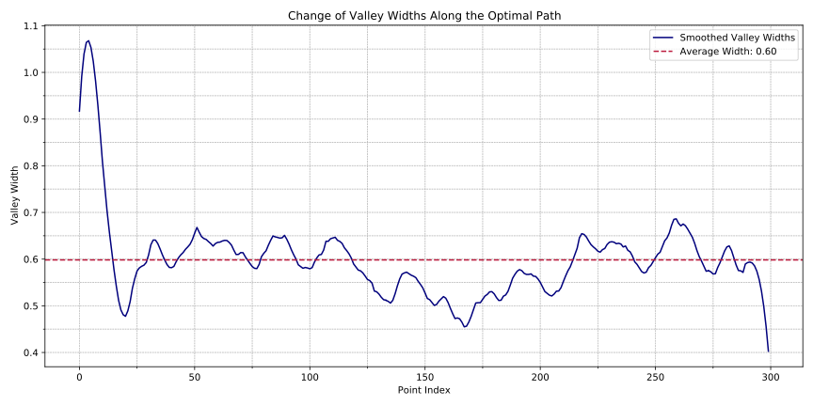
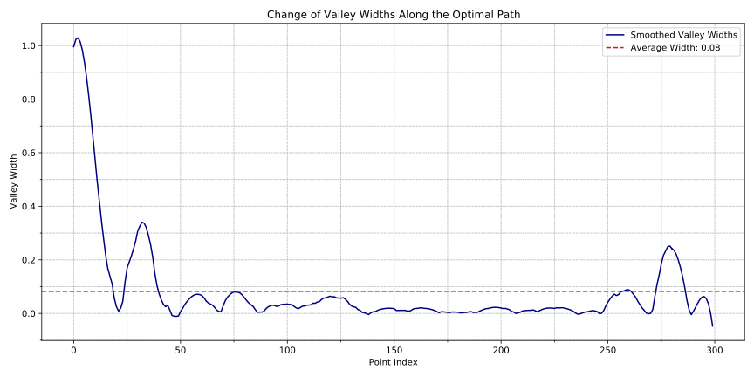
Idea 3 – Change of the valley width along the path
Observation Interval: 400
Scenario 1
Scenario 2

Slide 26
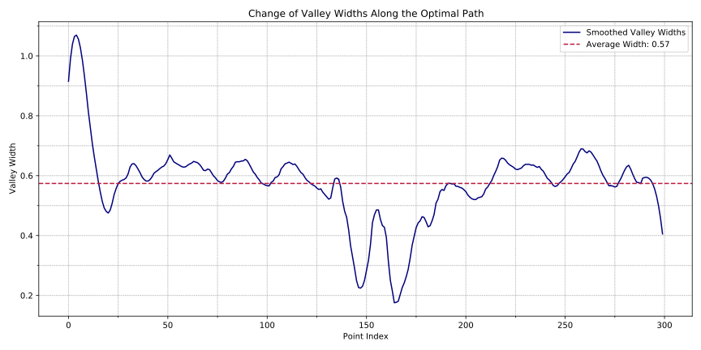
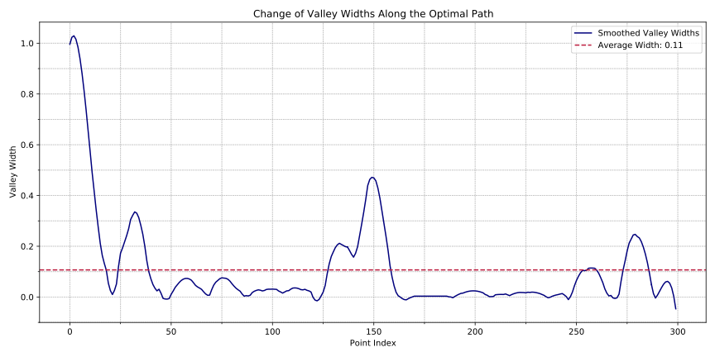
Idea 3 – Change of the valley width along the path
Observation Interval: 400
Scenario 3
Scenario 4

Slide 27
Idea 7: FlexDTW with a Sliding Window
Main idea: well-aligned segments give similar predictions from FlexDTW or full DTW, misaligned segments would not.
Strong match
Weak match

Slide 28
Idea 7: Some Implementational Details
We want this
Next window starts at this position
Window height = largest step * window width
Guarantees constant window resolution
Buffer = window width
Encourages longer, more coherent paths from FlexDTW
Not this

Slide 29
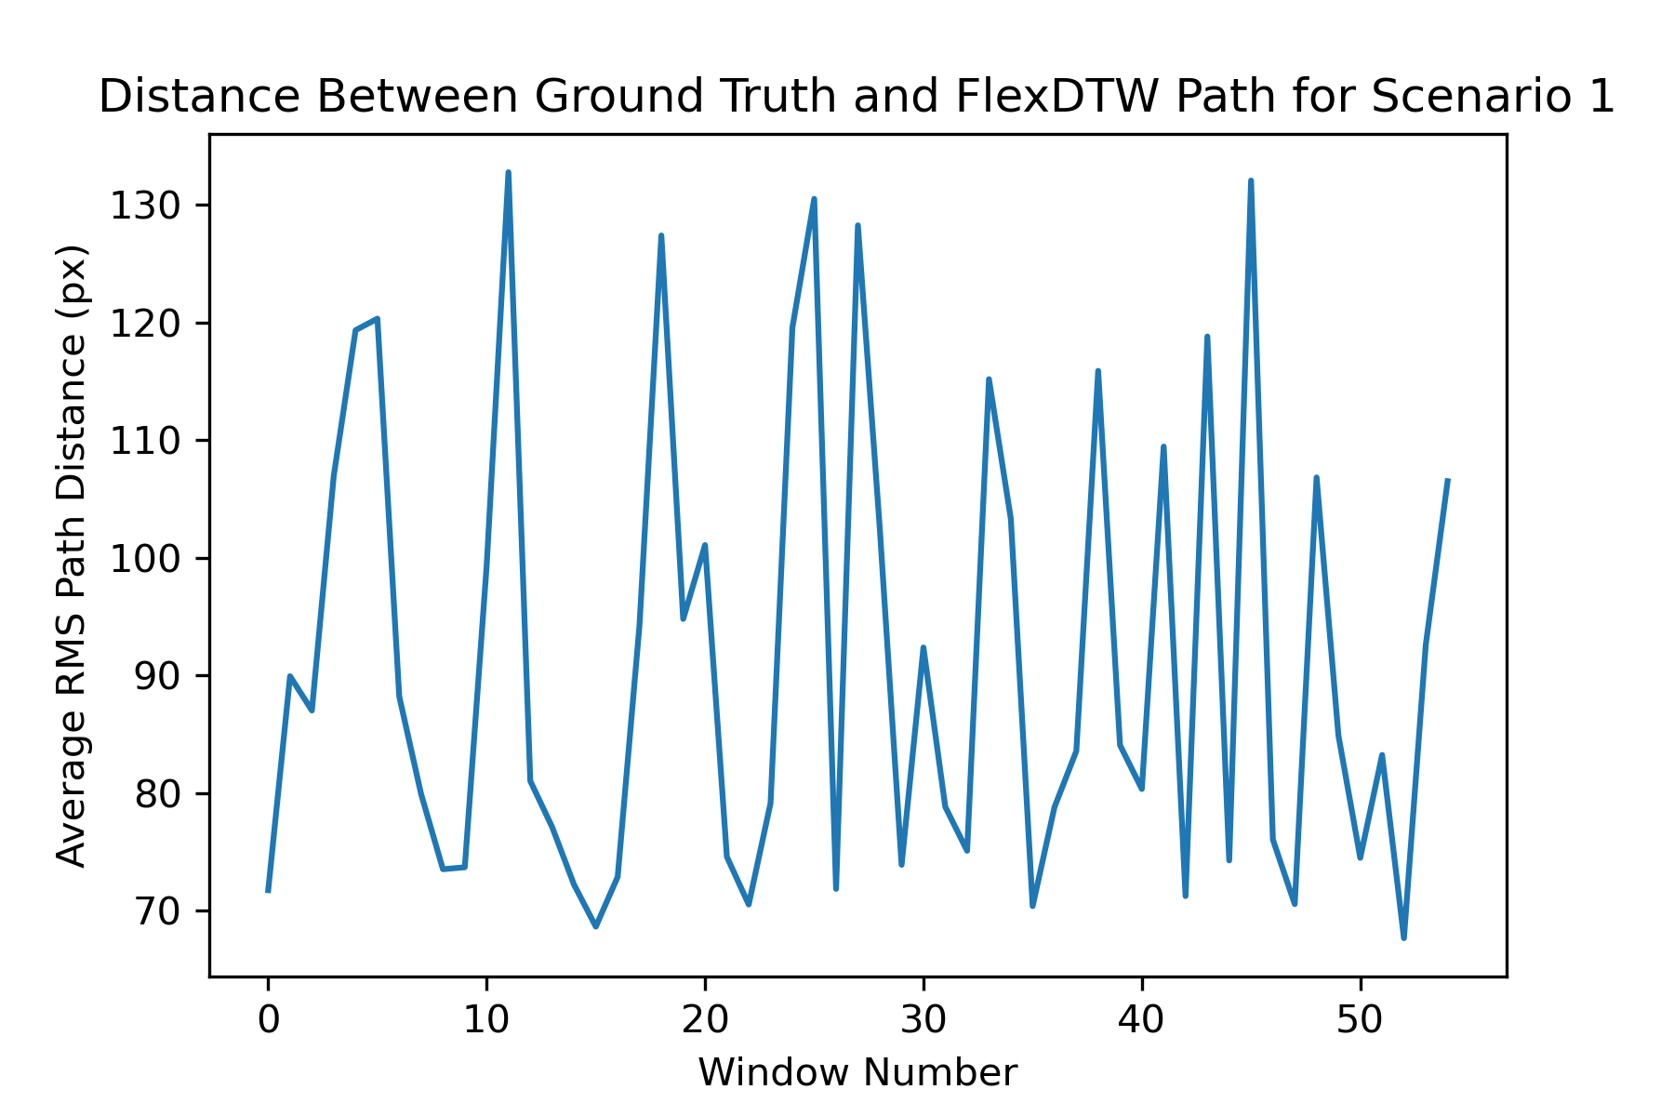
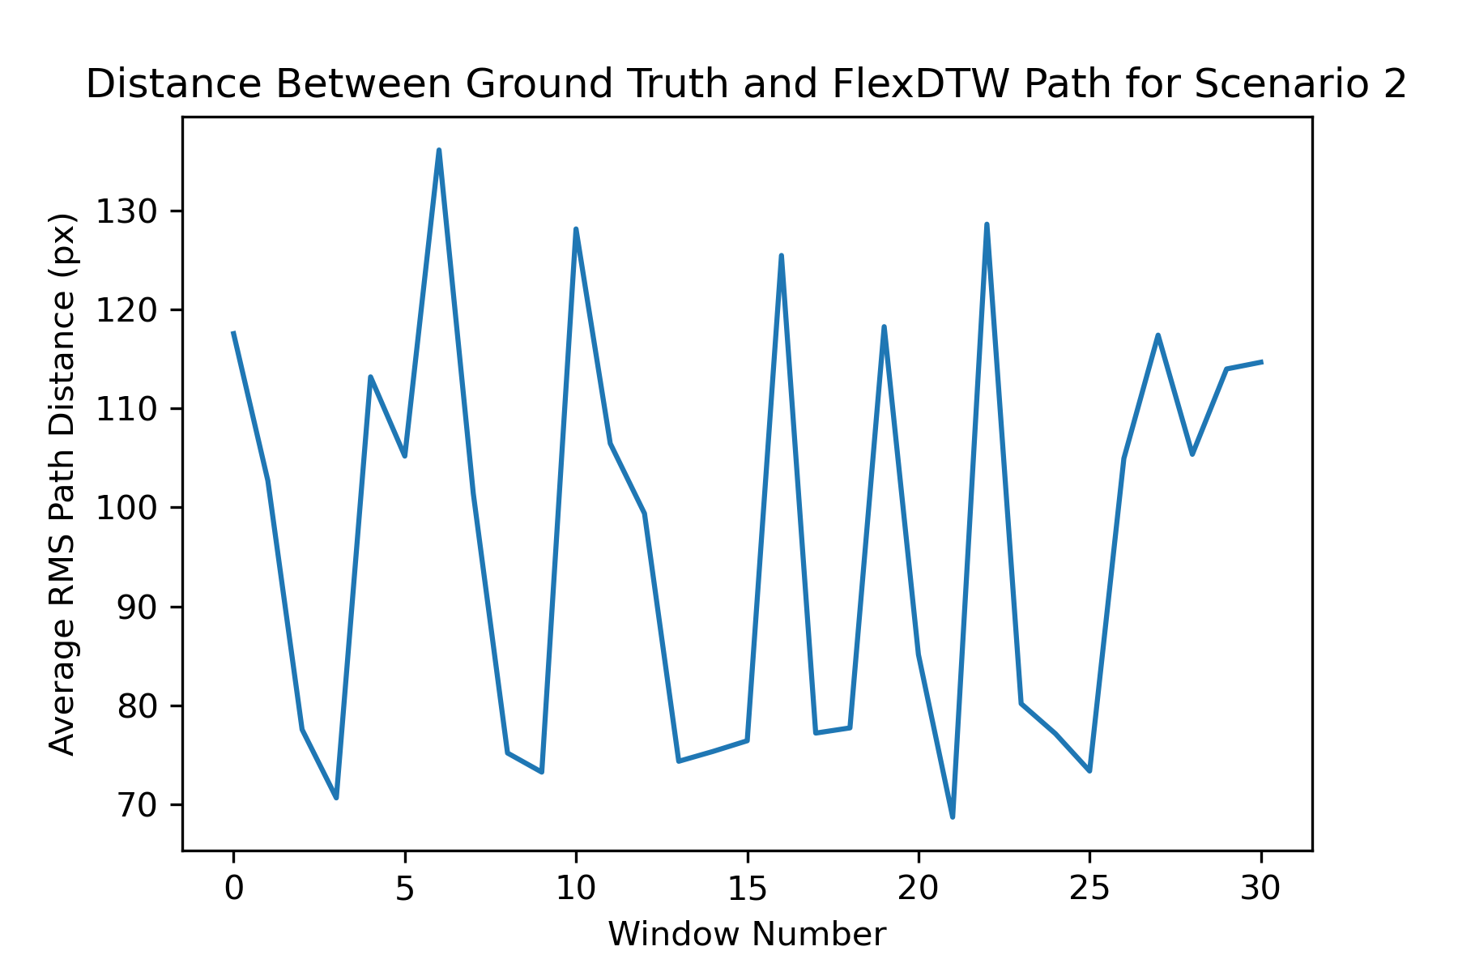
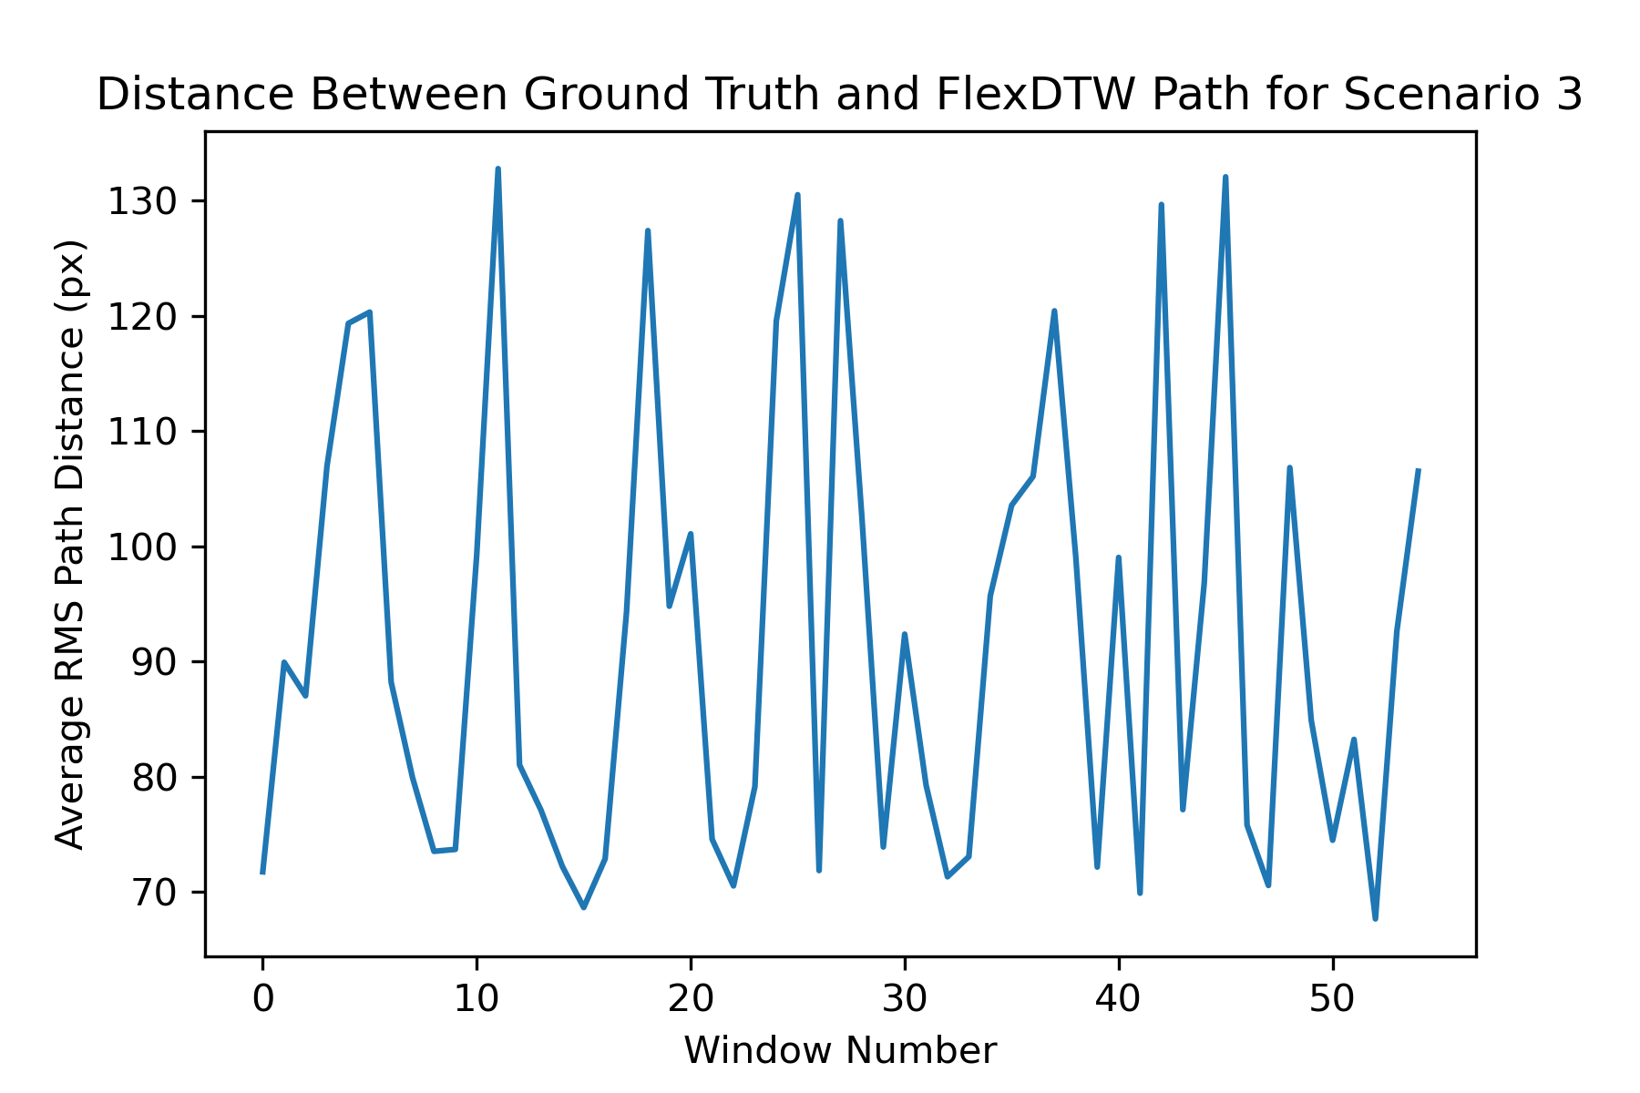
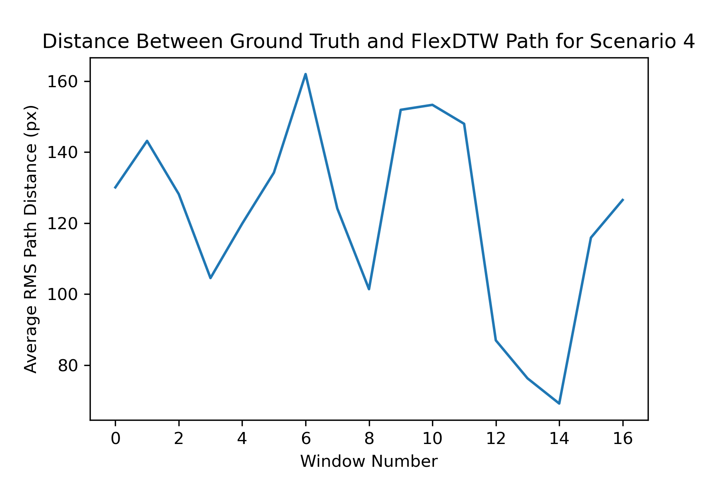
Idea 7: Results

Slide 30
Future Work
Idea 4:
error metric -> % confidence estimate (likelihood of match)
Idea 7:
Bug-fixing
error metric -> % confidence estimate
Subsequence alignment testing

